Slide 1

Post “Service Separation”
Approach to Service Design
Version 0.4
08/02/16
IBM Confidential

Slide 2
Contents
Background
Why should we tighten our service definitions?
Designing a new service
Trimming existing services
Options and Proposed Way Forward

Slide 3
Background
Prior to December 2015 the schemas designed for the NEM services for SO relied on the same IFW-based, canonical Transfer Object model (TOM).
This causes difficulties with change management and version control, as services could not be managed independently of one another
Over the Christmas period service schemas have been separated from each other, also known as the “Fire Break” initiative.
Each service now has its own TOM schemas. At the point of the Fire Break implementation, each of these was identical to the canonical TOM, albeit with service specific namespaces.
The design of service schemas was previously based on the premise of each service using the single canonical TOM.
This caused certain constraints around service designs. In order for the canonical TOM to be applicable across all services, it was generic, loose, and broad.
After Service Separation (Fire Break) we are no longer constrained in this way: in future we can make different service design decisions, and service TOMs can be more specific, tighter, and narrower.

Slide 4
Contents
Background
Why should we tighten our service definitions?
Designing a new service
Trimming existing services
Options and Proposed Way Forward

Slide 5
Why are message schemas useful?
Message schemas define the valid structure of a message. They are a powerful tool for:
Reducing defects. Schemas are used by senders to check that their message will be accepted by the receiver. Validity can therefore be tested in isolation, earlier in the project, without need for an integration test, and there will be fewer integration test defects as a result.
Faster development. Without schemas you would have to code the corresponding message validation, often in multiple places, and produce further code to deal with errors arising from this.
Improving Security. Schemas are used by receivers to protect themselves against malformed messages. This could also be done by hardware devices (DataPower).
Generating test tools. Schemas can be used to generate test stubs and test injectors (e.g. using SOAP UI), making testing quicker and more accurate.
Accelerating design. If a schema specifies the message unambiguously, there is less need for additional design documentation.
Within NEM, messages are based on XML, and schemas are based on XSD.
An XSD file can represent messages, or a set of transfer objects that can be reused by multiple messages.

Slide 6
XML Schemas: none vs. loose/broad vs. tight/narrow
Valid Messages
(from a business viewpoint)
Messages that comply with
a “tight” (or narrow) schema
Messages that
comply with a
a “loose”
(or broad)
schema
Well-formed XML messages
Before Fire Break,
because of schema re-use,
schemas were necessarily “loose” (or broad)
The space of all possible messages

Slide 7
XML Schemas: none vs. loose/broad vs. tight/narrow
Valid Messages
(from a business viewpoint)
With loose schema, you should test
that messages in this space result
in appropriate service behaviour.
That’s a lot of tests

Slide 8
XML Schemas: none vs. loose/broad vs. tight/narrow
Valid Messages
(from a business viewpoint)
With tight schema there are significantly fewer of such tests

Slide 9
Fire Break enables tighter message schemas
Tightening messages to be more specific to a process or service can lead to reductions in:
future design effort because less documentation would be required to tighten (and clarify) service specifications when the schema themselves are already tight;
build effort as it will remove the need to hard-code additional validations (and the corresponding exceptions to be handled by consumers);
test effort as fewer code paths need testing;
integration test effort because defects can be discovered earlier (i.e. unit test based on the schema);
security risks that may arise from potential errors in validation code;
performance & operational risks that may arise due to the size of the loose/broad schema.

Slide 10
Contents
Background
Why should we tighten our service definitions?
Designing a new service
Trimming existing services
Options and Proposed Way Forward

Slide 11
Example: ArrangementSetup, Modify Product Arrangement
New increment 5 service
One service operation to support Tranche Switch
Input:
  Arrangement Identifier (of the arrangement to be switched)
  Product Identifier (of the product to switch to)
Output:
  Success or Error code
How would we design this?

Slide 12
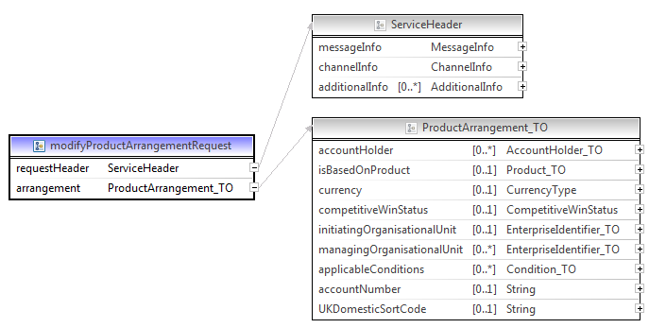
Default Schema

Slide 13
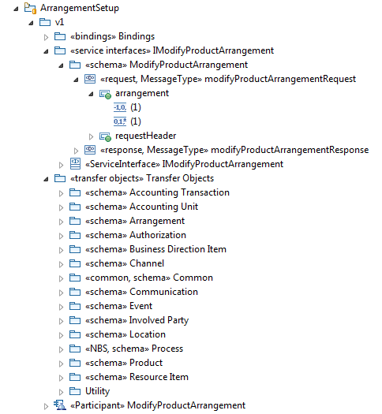
Default Schema

Slide 14
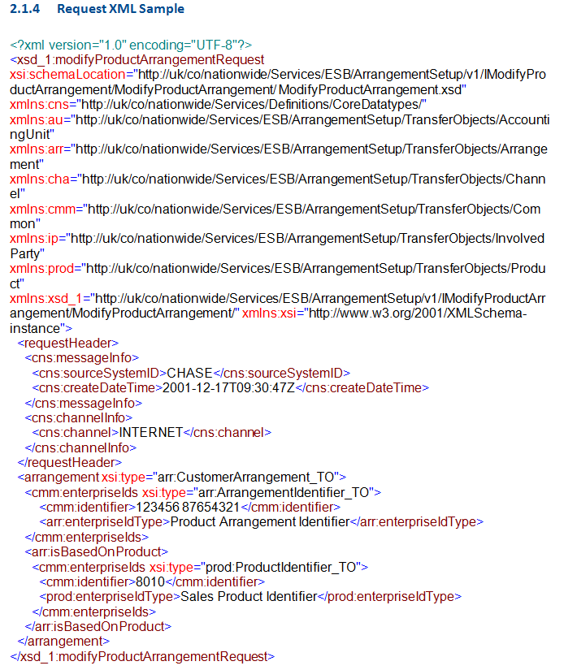
Default Sample Message
<….schema references / imports …./>

Slide 15
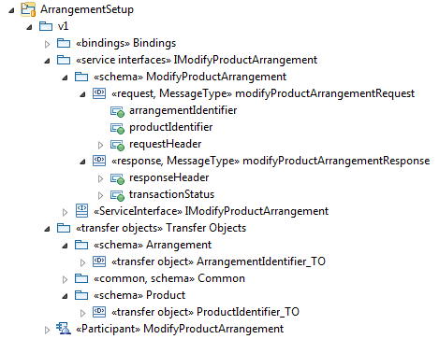
Minimalist Alternative: Schema

Slide 16
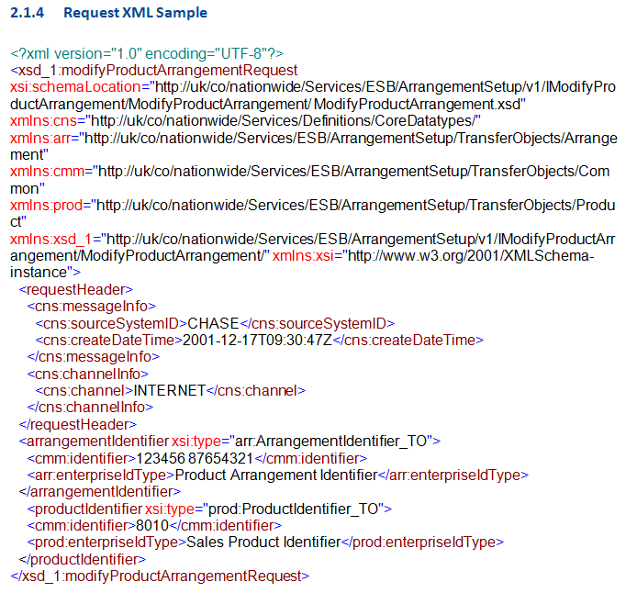
Minimalist Alternative: Sample Message
<….schema references / imports …./>
We could go even further by
specifying the two identifiers
as basic strings

Slide 17
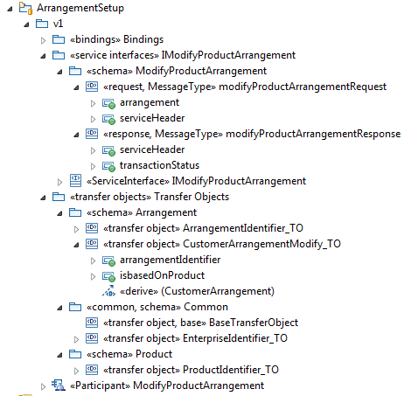
Balanced Design

Slide 18
Design Principles (to be refined as they are applied)
First consider the requirement, i.e. what the consumer(s) of the service require.
Don’t include anything you don’t need, and remove what you don’t need.
  For most services, it’s probably most practical to start with the master TOM, though a “blank sheet” may be appropriate for very small services.
  See the later slide “Trimming Procedure” for instructions how to remove unneeded elements.
Remove inheritance where it isn’t useful.
  It is okay to create your own element type
  In the “Modify Product Arrangement” example:
    Instead of a “CustomerArrangement_TO”
    inheriting from a “ProductArrangement_TO”
    inheriting from a “Arrangement_TO”
    inheriting from a “BusinessModelObject_TO”,
    each derived from their respective IDM classes…..
    … we simply chose to have a single “CustomerArrangementModify_TO”
    derived from the “CustomerArrangement” IDM class, and with two elements
    This TO can grow to accommodate further changes that may be required to a Customer Arrangement. If and when necessary or useful, inheritance may be re-introduced based on the example provided in the IDM and master TOM.
Make elements mandatory.
  If elements are mandatory in one service operation but not another, consider creating operation-specific, specialised objects.
Use of Object Reference and Enterprise Identifier TOs is not mandatory.*
  If a simple string attribute suffices for the service, use this instead.
Replace instances of run-time polymorphism by a choice element.*
  Create a new datatype with stereotype “complex type”
  In stereotype properties, select a modelGroup of “1 – choice”
  Add attributes to this datatype of the types that would have been allowed if you had used polymorphism, and remove what you don’t need.
* These principles are not shown in the “Modify Product Arrangement” example

Slide 19
Contents
Background
Why should we tighten our service definitions?
Designing a new service
Trimming existing services
Options and Proposed Way Forward

Slide 20
Why trim existing services?
Why trim and not redesign?
  Trimming does not affect existing consumers and services already built and tested, other than having to re-import a new set of WSDLs and XSDs.
Why trim at all?
  Trimmed schema do provide tighter, machine readable, definitions of the services, with the associated advantages discussed.
Valid Messages
(from a business viewpoint)
Messages that comply with
a “tight” (or narrow) schema
Messages that
comply with a
a “loose”
(or broad)
schema
Messages that comply with
a trimmed schema

Slide 21
Example: CommunicationDispatch, GenerateCommunicationDetails
Asynchronous, Fire-and-Forget service
According to the requirement, the message consists of:
  The Target of the communication
    Individual
    Name
    Role (e.g. account holder)
    Registration
  Purpose (e.g. template ID)
  Contact Points communication is targeted at
  A Content Object, a polymorphic type based on “Business Model Object”

Slide 22
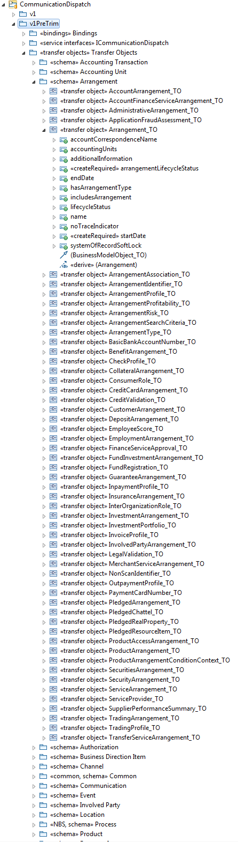
Solution before “Trimming”

Slide 23
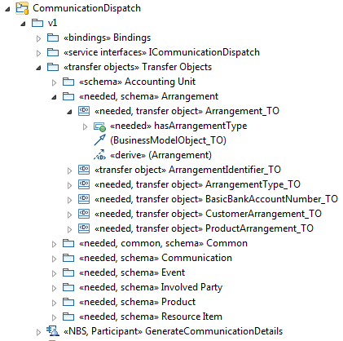
Solution after “Trimming”

Slide 24
Trimming Procedure
Rename the v1 folder of the service as v1PreTrim.
Copy this folder and rename it as v1.
For each service operation, for both request and response object:
  For each root element except service header:
    Mark its TO as “needed” (see below)
    For each attribute present in the example in the interface spec, and each attribute mapped in the functional spec:
      Locate the attribute in the service TOM
      Mark the attribute as “needed” using keywords/stereotypes.
      Mark the TO type of the attribute as “needed” (see below)
Mark TO as “needed” =
  Mark the TO type of the element, and its schema, as “needed”
    Until you reach “BaseTransferObject”:
      Mark the TO it inherits from as “needed”
Remove all schemas not marked “needed”
Within the remaining schemas remove all TOs not marked “needed”
Within the remaining TOs, remove all attributes not marked “needed”
Regenerate WSDL and XSDs
Revalidate examples using XMLSpy
  If you deleted too much:
    Copy the attribute / its TO type / its TO supertypes / its schema package (whichever applies) from v1PreTrim.
    Trim the items you copied as per above procedure until you’re left with the attribute(s) you need
    Of the items you copied, correct relationships pointing to objects in the v1PreTrim folder to point to the same objects in the v1 folder
    Revalidate etc.
Remove v1PreTrim
Release new WSDLs and XSDs.

Slide 25
Further Investigation: Automating Trimming
The Data Team have maintained a database of all fields required by SO1 and their mappings.
This could possibly be used to automate the initial trimming of the master TOM for each service.
Requires scripting / coding of RSA plugin

Slide 26
Contents
Background
Why should we tighten our service definitions?
Designing a new service
Trimming existing services
Options and Proposed Way Forward

Slide 27
Options
Revert back to full TOM everywhere
Trim new services only
Trim new and existing SO services
Proposed Approach: Trim existing services. Design new services according to new principles.
Redesign all SO services according to new principles

Slide 28
Implementation Approach
For increment 5 and initiatives post-SO1, services are to be designed as per the design principles set out earlier.
These principles will be refined as we are performing the designs.
  For example, we need to review documentation principles as lighter-weight specification documents will become possible
SO1 increment 1-4 services will be trimmed as a background task.
  While a service TOM is in the process of being trimmed, we may have to perform duplicate fixes. Therefore, although trimming is a background task, it will need to be planned to ensure that each service spends a minimum amount of time in this “half-way” state.
  There are two services which change from increment 4 to increment 5. We must first trim these, in the increment 4 stream, and roll-forward the changes to the increment 5 stream. We can then apply the increment 5 changes.

